Slide 1
Startups & Entrepreneurship
Drew Harmon
Notes:
the world of startups: the challenges, the process, the risks/rewards, etc.

Slide 2




Quick Bio
This Talk
B.S. Computer Science, Stonehill Class of 2005
Three Startups - Pragmatech (now Upland Qvidian), DRG, Trimpakt
My Experience
What is a Startup?
What Should I Expect?
How do I Get Started?
Conclusion, Q & A

Slide 3
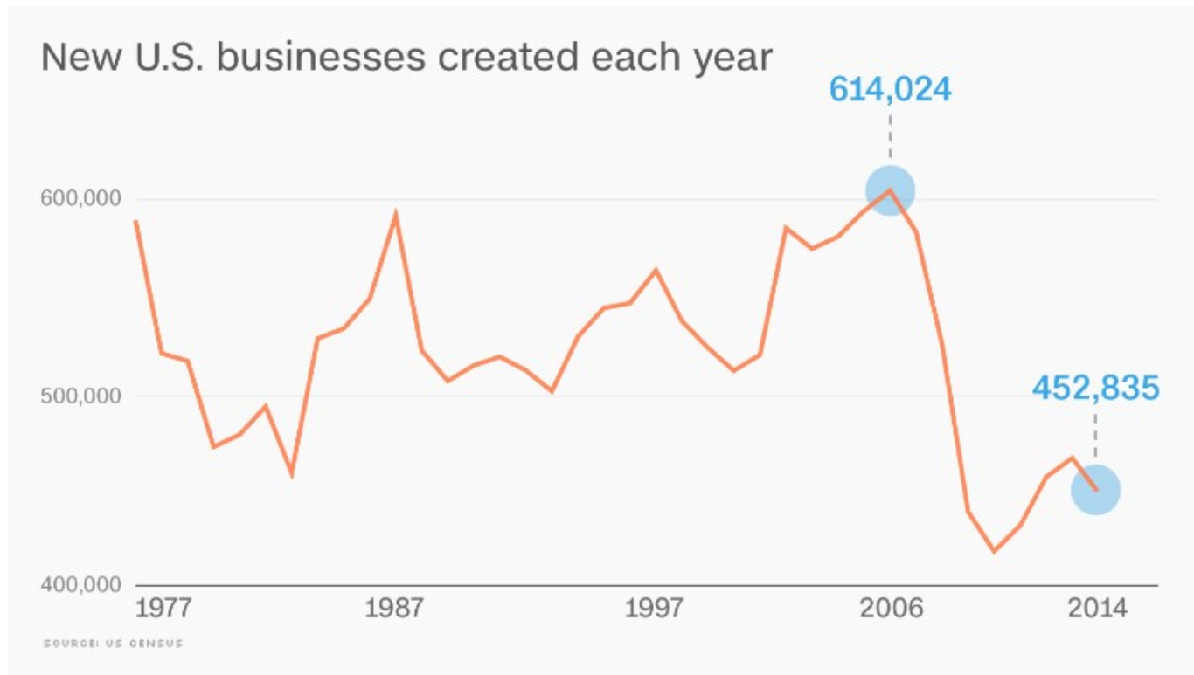
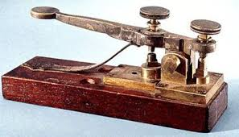




Why Talk About Startups?
Startup creation is near a 40 year low
Notes:
According to recent studies, the rate of startup creation has been decreasing for years. People are starting fewer businesses and taking fewer risks.

Slide 4
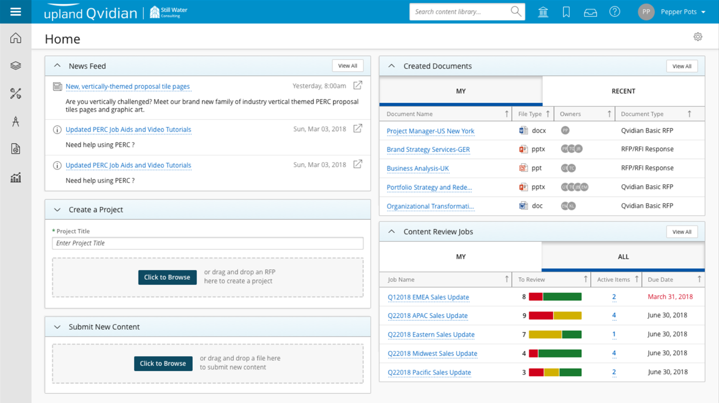
Pragmatech - 2005
Customer Relationship Management
Automated Requests for Proposal
Brief History
2003 - Raised a $12 million Series A
2005 - Additional $8 million Series B
2007 - Product Launch & Rebranding
2010 Onward - Mergers, Layoffs, Stagnation

Slide 5
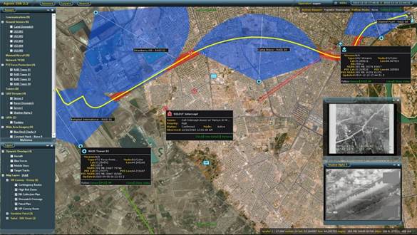
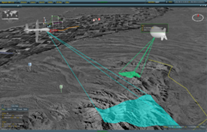
Digital Results Group - 2009
Defense & Aerospace
Brief History
2007 - Founded (2 Co-Founders)
2009 - I Joined as Employee #4
2011 - Navy & DARPA Contracts, Rapid Growth
2014 - Sold to Novetta

Slide 6
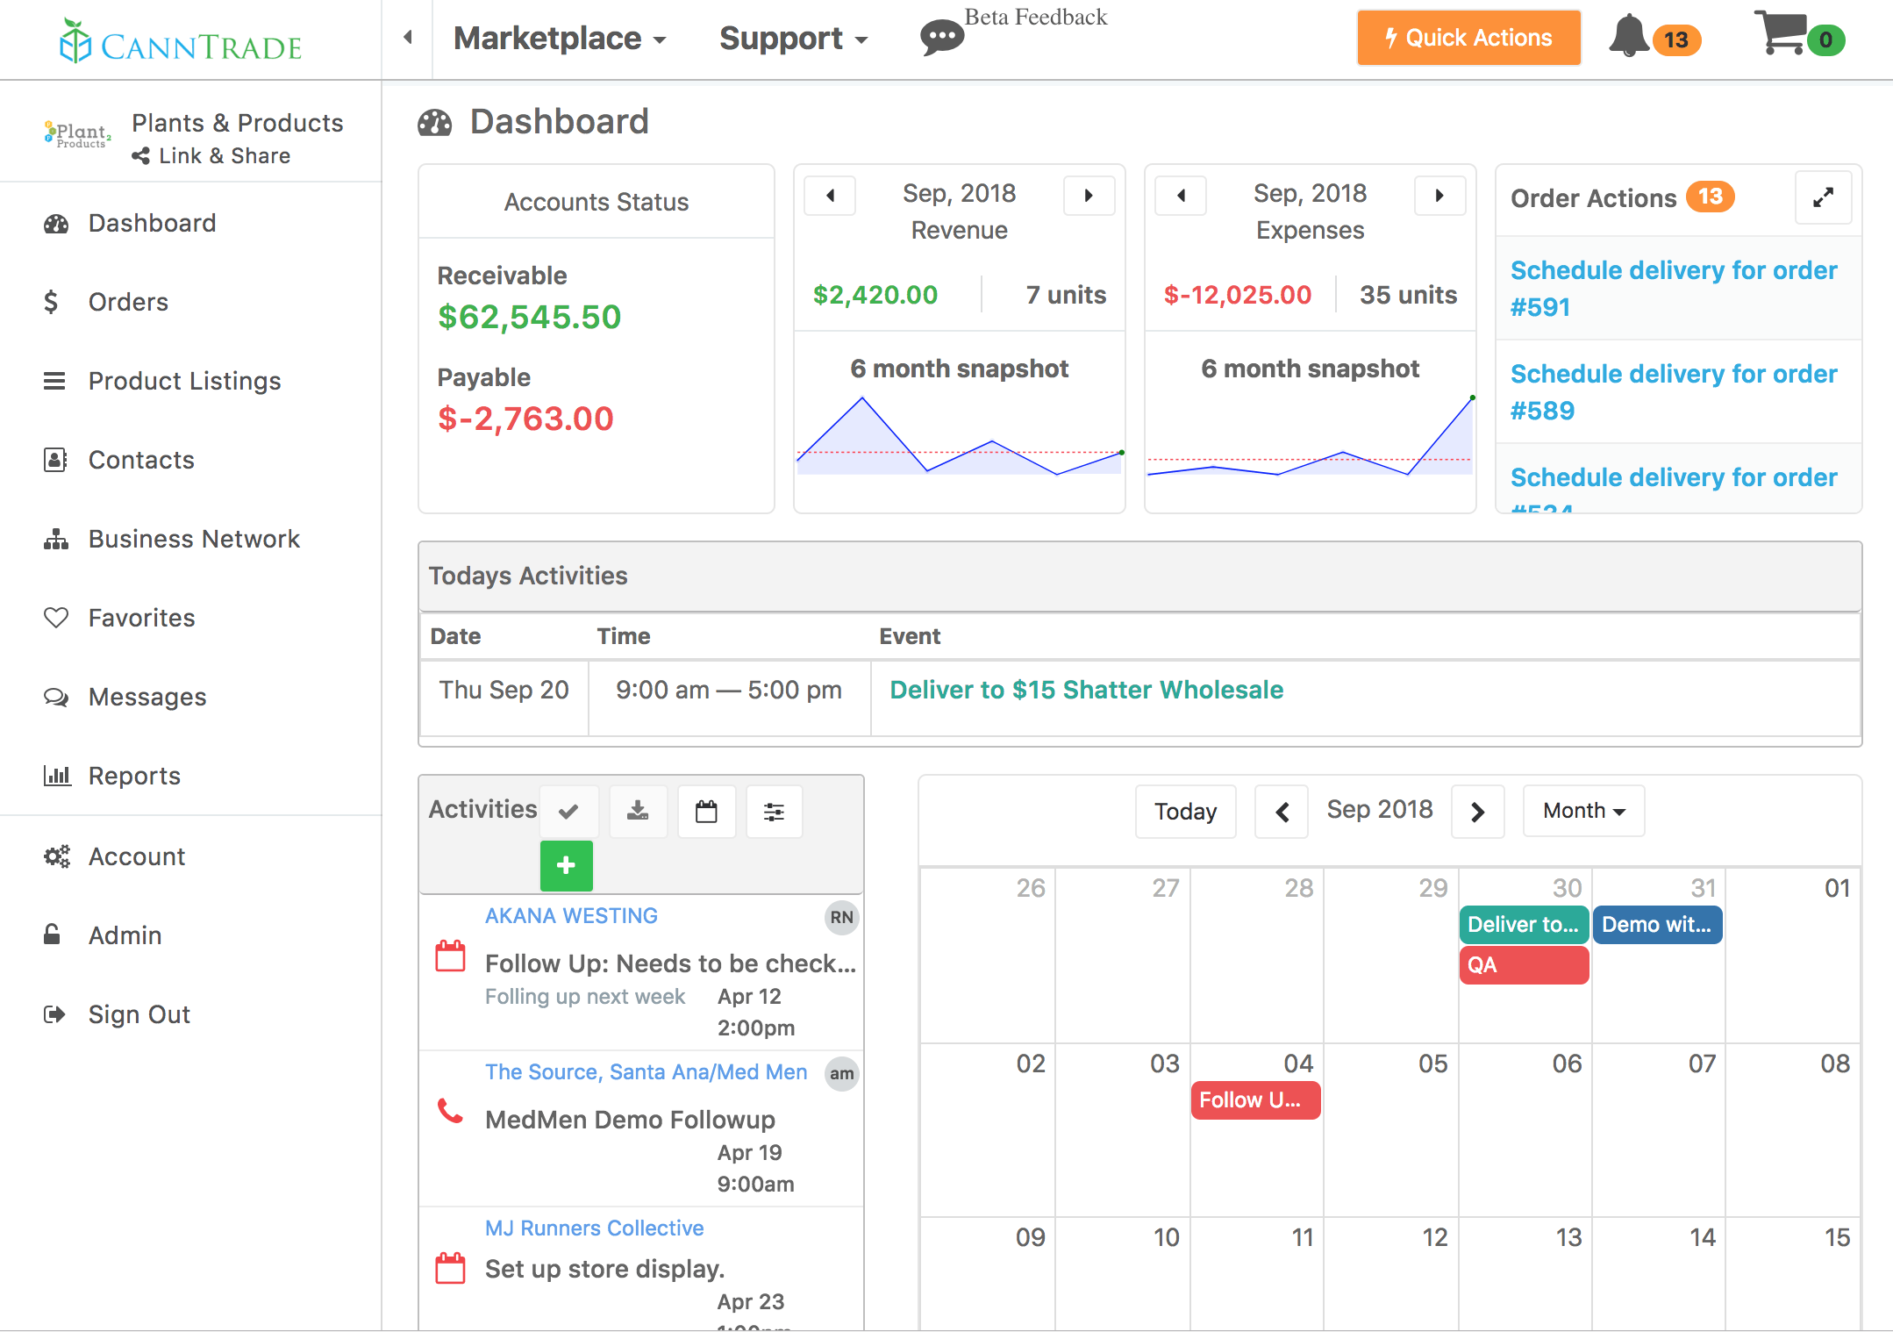
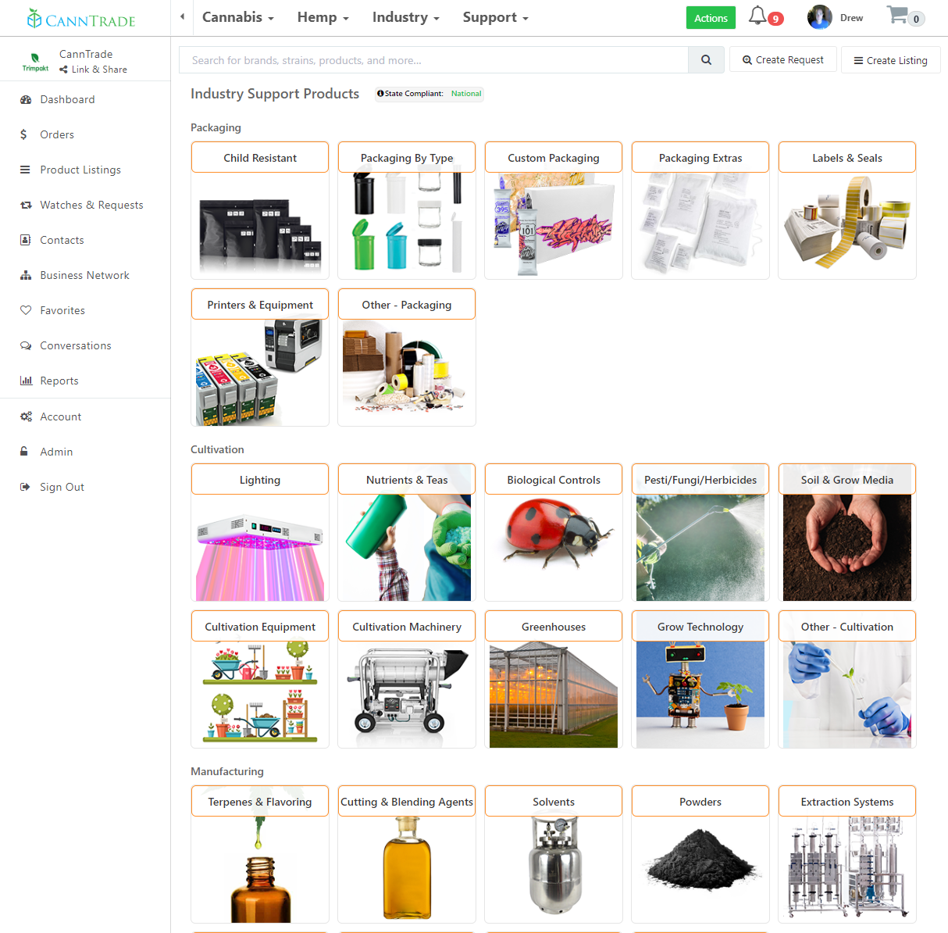
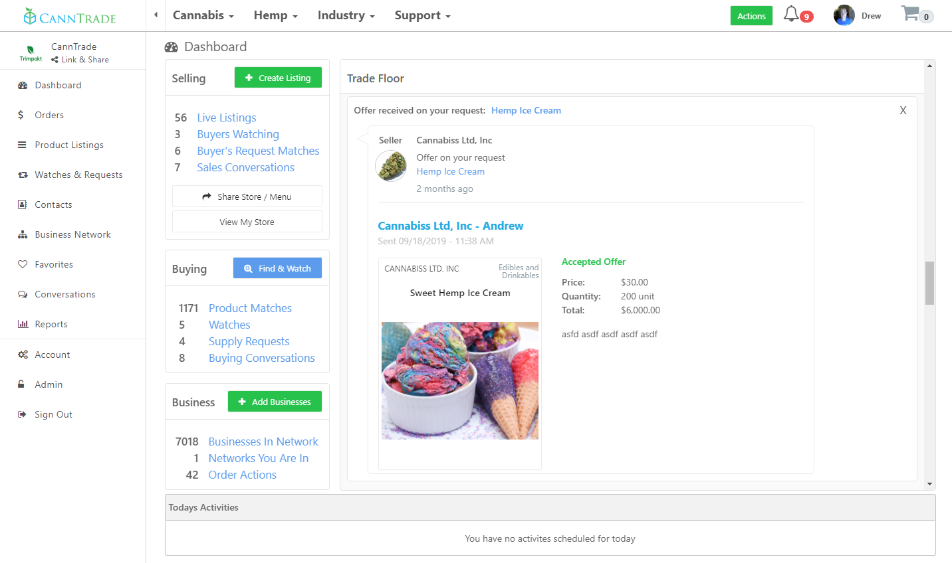
Trimpakt - 2016
Legal Cannabis & Hemp
Wholesale B2B Marketplace, CRM & Compliance
Brief History
2016 - Co-Founded (4 partners)
2017 - Beta Release + Iterate
2019 - Official Product Launch

Slide 7
What do you think when you hear the term startup?

Slide 8
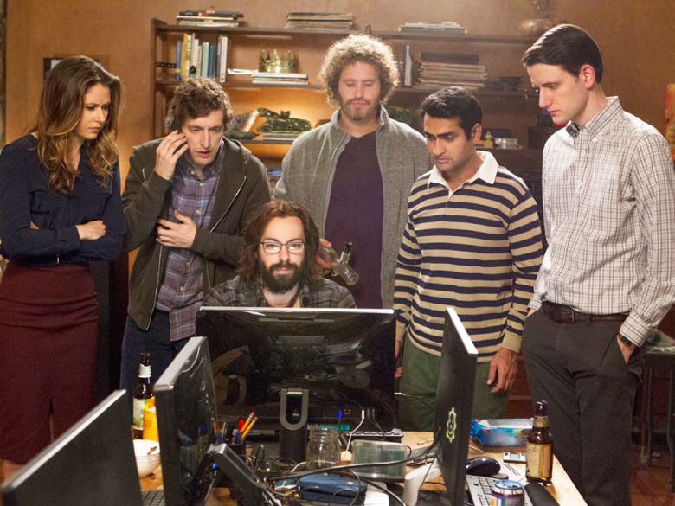
Startup Traits
Designed for rapid growth & scalability
Large target audience or customer base
Generally technology focused
Typically requires funding
Goal is usually investor and/or founder exit
Notes:
Small businesses are not the same thing. A new barbershop is not a startup, its a small business.

Slide 9












Starting Is Easy
Barrier to entry for tech startups is extremely low
Source Control
Hosting
Deployment
Development

Slide 10
What Should I Expect?

Slide 11

The Good
Be your own boss
Work when and where you want
Define your own company culture
Learn a lot (about technology and yourself)
Personal fulfillment
Might make a lot of money

Slide 12

The Bad & The Ugly
Hard Work
Long Hours
Low to No Salary & Benefits
Poor work / life balance
No Stability
Mental Toll - Anxiety, Insomnia, Stress, Depression
Physical Toll - Sedentary lifestyle, poor eating habits

Slide 13

So You Want to Build a Startup?

Slide 14



Getting Started
Ideas
Partners
Funding

Slide 15

Ideas
“The way to get startup ideas is not to try to think of startup ideas. It's to look for problems, preferably problems you have yourself.”
-- Paul Graham, Y-Combinator
Notes:
Look around you for problems. Think of things in your life that could be easier. Pay attention to when you are annoyed, frustrated, angry at a process or product. http://www.paulgraham.com/startupideas.html

Slide 16
Choosing Partners
Find people that…
Share Your Vision
Complement Your Skill Set
Argue Constructively
Aren’t Afraid to Tell You No
You Can Terminate a Relationship With

Slide 17
Funding Options
Bootstrapping
Friends & Family
Venture Capital / Angel Investor / Private Equity
Crowdfunding
Bank Loan

Slide 18
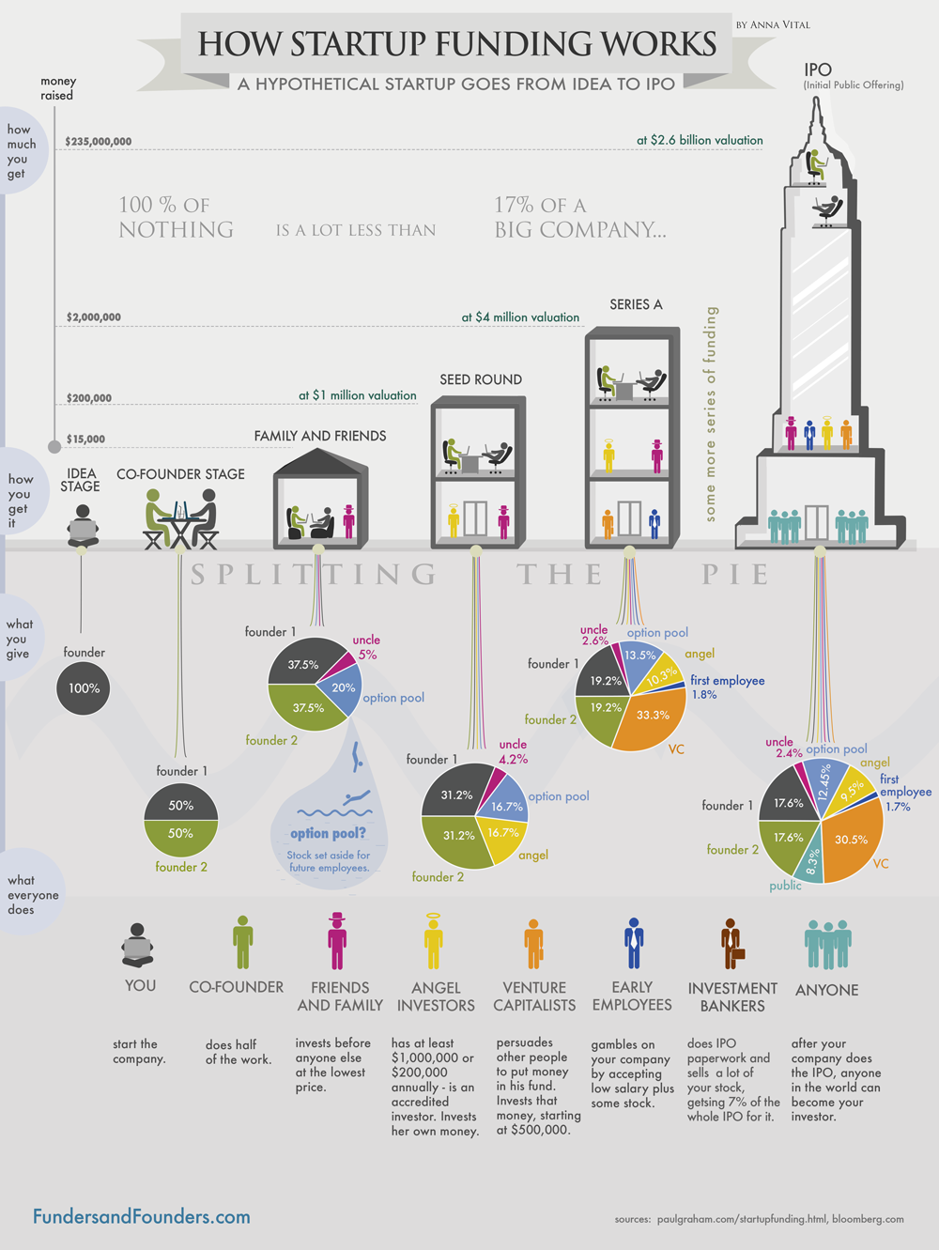

Slide 19


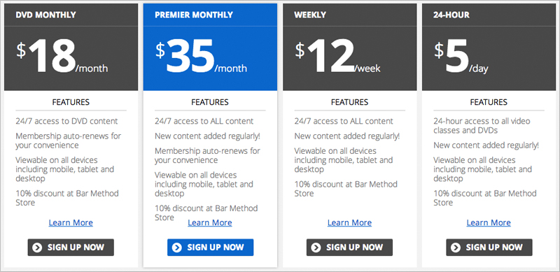

The Game Plan
Incorporate
  LLC
  S-Corp
  C-Corp
Founders Agreement & Company Bylaws
  Stock & Ownership Structure
  Voting Procedure
  Have the Argument Early
Develop a Pricing Model
  Subscription
  Pay per service
  Advertising
Build, Release, Iterate
  Listen to your customers
  Don’t ignore sales & marketing!

Slide 20
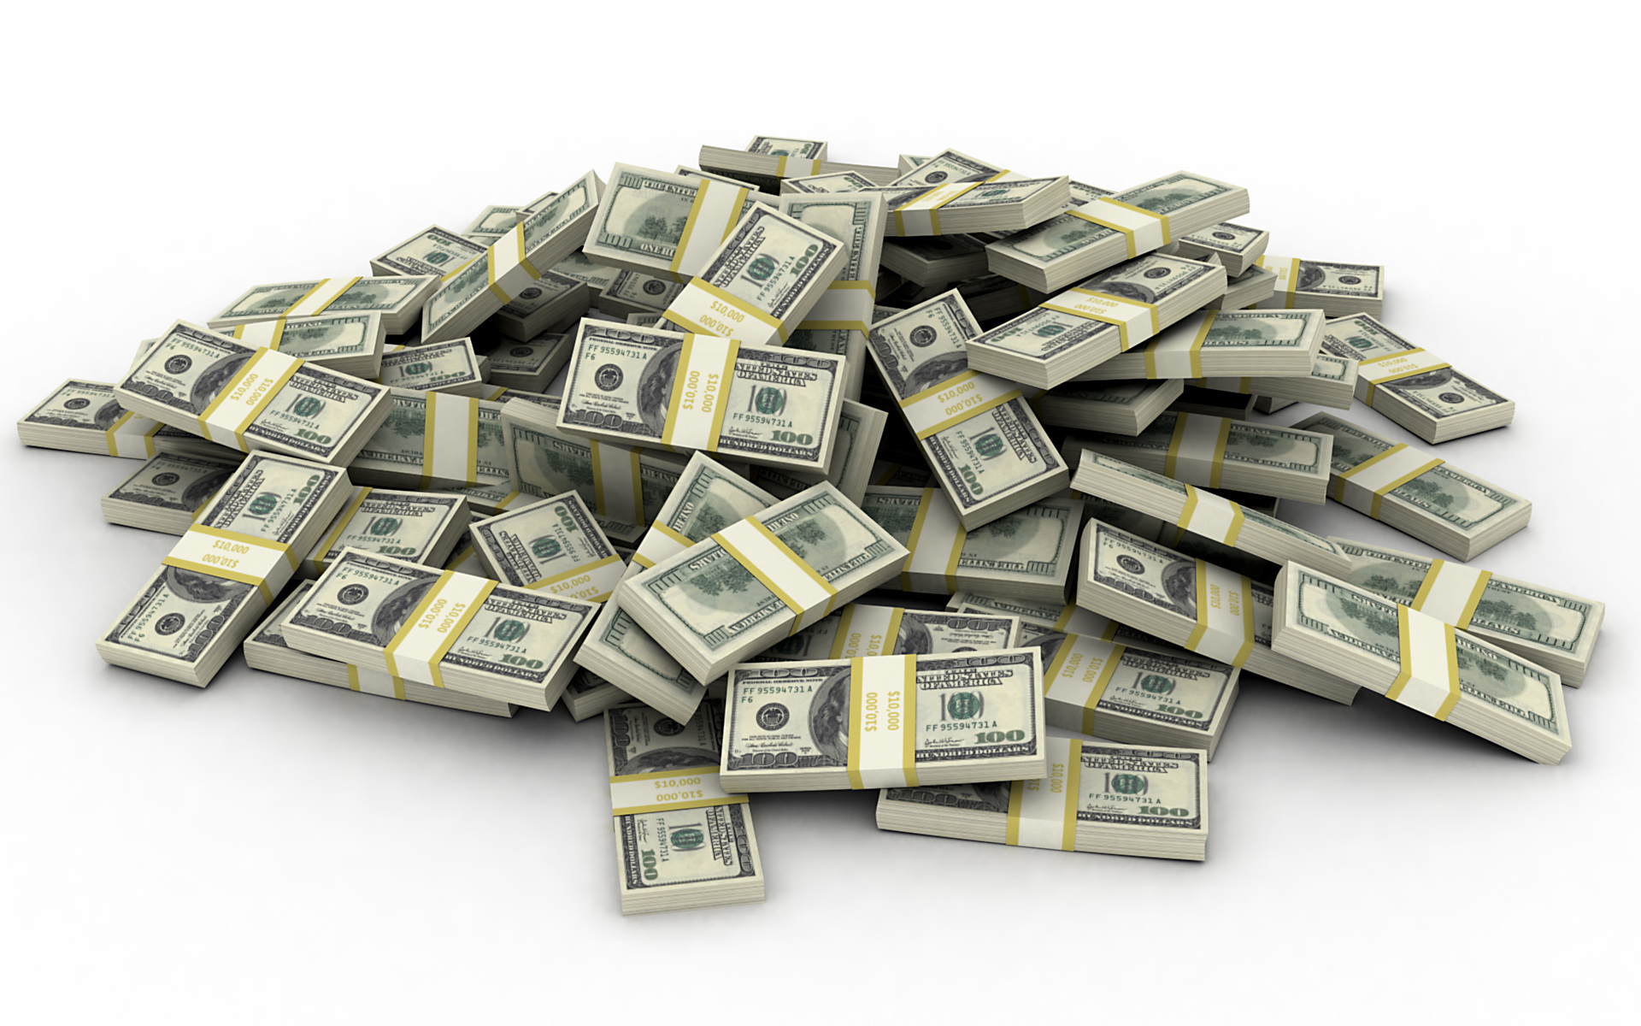
Exit Strategy
Investors Want ROI...
IPO
Sale
Distributions / Dividends

Slide 21

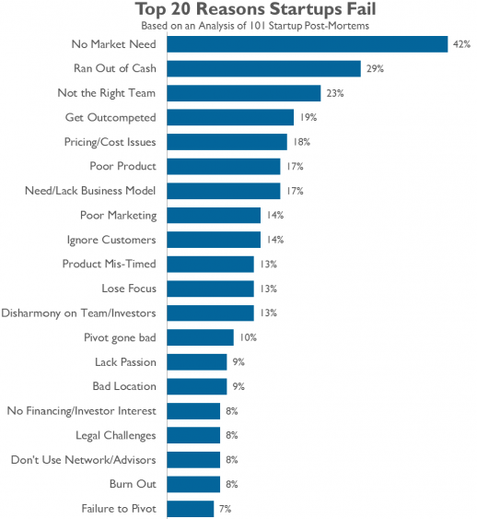
Most Startups Fail

Slide 22
Takeaways
Creating Something Can be Incredibly Rewarding
Everyday is a School Day
Don’t Go it Alone
Getting Started is Easy, Success is Hard
Don’t Forget to Take Care of Yourself

Slide 23
Suggested Reading
The Founder's Dilemmas: Anticipating and Avoiding the Pitfalls That Can Sink a Startup
- Noam Wasserman
Zero to One: Notes on Startups, or How to Build the Future
- Peter Thiel
The Hard Thing About Hard Things: Building a Business When There Are No Easy Answers
- Ben Horowitz
Masters of Doom: How Two Guys Created an Empire and Transformed Pop Culture
- David Kushner

Slide 24
Q & A

